Slide 1
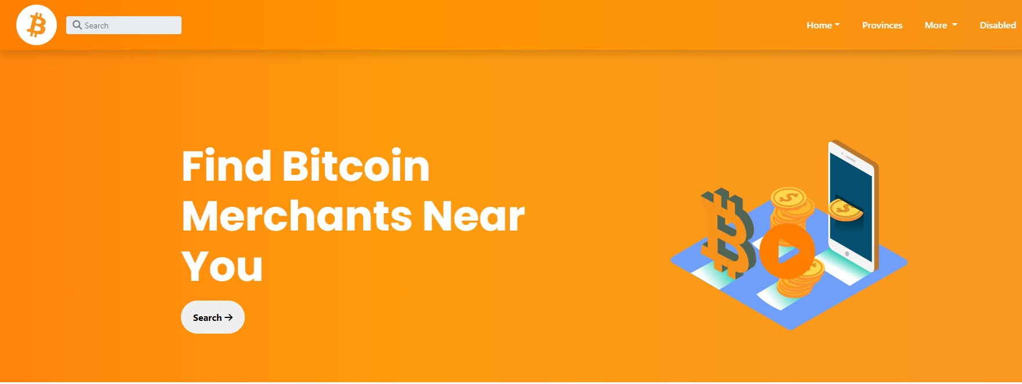
BITCOIN RADAR PHILIPPINES
Home Blog Services Contact FAQ
MINI-1 PROJECT
PRESENTATION

Slide 2
WD31 GROUP-8
Group Members:
Alay:
Alden Panganiban Vidal
Members:
Marc Ernest Bagu Kagahastian
Mark Joseph Libres Ortizano

Slide 3
Objective / Purposes
Help users to find businesses and services that accept bitcoin as mode of payment.
Provides Merchant Location, Information, many more.
Promote/Boost and help businesses reach more exposure and engagement.
Not a booking site.
soon this WebSite will helps a lot of Traders.

Slide 4
MISSION:
Bitcoin was created as a way for people to send money over the internet. The digital currency was intended to provide an alternative payment system that would operate free of central control but otherwise be used just like traditional currencies.
VISION
Bitcoin is so powerful and has so much potential, Bitcoin's projected value and estimated growth could be astronomical. Speculation from crypto analysts and industry experts suggests that Bitcoin's long term value could reach over $100,000 to as much as one million dollars per BTC in the future.

